Slide 1
Polygraph Testing and Test Data Analysis in Review
Chip Morgan

Slide 2
Analysis of WHAT?
Too often, examiners think of test data analysis as merely chart scoring.
In actuality, if we test over faulty questions, score data of marginal quality, analyze data using incorrect methods or utilize incorrect cut scores, the diagnostic opinion is suspect.
Proper test data collection consists of:
Correct test question construction
Demonstrated understanding of test questions by the examinee
Proper numerical analysis of the data.
Application of the numerical totals to cut scores.

Slide 3
Testing Principles

Slide 4
In Appreciation to
Donald J. Krapohl
For the use of some of his material in this presentation

Slide 5
Remember: Policy
is not
Science

Slide 6
Remember: Policy is not Science
What do we mean by this?
We’ve always done it that way…
I was taught that way and I cannot change…
As long as I do what I was taught in school, I will be covered for liability in court…
If I use a Federal Zone or MGQT, the federal government will testify for me in court (No, No, No, absolutely NOT)…
My agency says we cannot have inconclusive results…

Slide 7
Polygraph Basics – “The Big 6”
We must begin at a (relatively) homeostatic level.
We must develop unambiguous stimulus (questions), free from unintended stimulus (noise or outside issues).
We must use validated testing techniques.
The charts must be properly annotated.
The timely reactions to the stimulus must be properly analyzed and numerically scored, with artifacts discounted.
The numerical score must be applied to cut scores derived from normative data.

Slide 8
Polygraph Basics – What is Homeostasis?
Homeostasis: Refers to a complex interactive regulatory system by which the body strives to maintain a state of internal equilibrium (basically think of it as BALANCE).
Being able to recognize an examinee’s homeostatic signature, for each of the recording systems being monitored and recorded, is essential to effective test data analysis.
Examiners often use the following terms interchangeably with homeostasis: physiological norm, pre-stimulus baseline, resting state, and tonic level.

Slide 9
Math Problems
It has been estimated that
85% of people have problems with math.
Thankfully, most examiners are part of the other 25%

Slide 10
Example - Math Problem – Instructions
Do Not Talk during the problem
Do Not collaborate with your neighbor
Write down your answer
Prepare to defend your answer

Slide 11
Simple Math Problem – Solve Individually
(18 ÷ 3) – 7 + 2 x 5

Slide 12
Class Problem – Is It 5?
(18 ÷ 3) – 7 + 2 x 5
(6)-7 (-1) + 2(+1) x 5 (5)
5 = right?

Slide 13
Class Problem – Is the answer 9?
(18 ÷ 3) – 7 + 2 x 5
(6) – 7 (-1) + 2 x 5 (10)
-1 + 10
= 9

Slide 14
How can we be so divided in our answers?
How many people think the answer is 5?
How many people think the answer is 9?

Slide 15
The CORRECT answer is 9
Problem: (18 ÷ 3) -7 + 2 x 5
18 ÷ 3 = 6
2 x 5 = 10
6 – 7 = -1
6 - 7 +10 = 9

Slide 16
What is the reason for the wrong answer?
(18 ÷ 3) -7 + 2 x 5
The reason some of us got it wrong was because we didn’t follow all the rules.

Slide 17
PEMDAS
The Order of Operations is an instruction sheet to solve equations.
Parentheses
Exponents
Multiplication and Division
Addition
Subtraction

Slide 18
Order of Operations - PEMDAS
The Order of Operations is an instruction sheet to solve equations.
Parentheses (solve Parentheses first)
Exponents
Multiplication and Division (after P and E - Left to Right)
Addition (after P, E, M and D - Left to Right)
Subtraction (after P, E, M and D - Left to Right)

Slide 19
Re-look at the equation using PEMDAS
Problem: (18 ÷ 3) -7 + 2 x 5
18 ÷ 3 = 6
2 x 5 = 10
6 – 7 = -1
6 - 7 +10 = 9

Slide 20
How Does This Apply to Polygraph?
In the preceding math problem, we have seen that if we operate without instructions (Order of Operations, PEMDAS) we may arrive at an incorrect conclusion – even though it “seems” correct.
In polygraph, if we disregard the basic principles of polygraph, we run the real risk of coming to an incorrect diagnostic opinion.

Slide 21
The Lack of Research
There is no overarching theory for test question construction, only general principles.
Those principles are not rooted in any evidence. Disagreements abound.
If we believe we are testing for lies we will sometimes error in test question construction and presentation.
We need a better framework for developing and presenting test questions.

Slide 22
The Paradigm – Simplicity Itself
Polygraph testing is a stimulus-response (S-R) paradigm.
Test questions are the stimuli (not the examinee’s answer.)
Physiological arousals are the responses.

Slide 23
Stimulus
Response

Slide 24
The Variables
Independent: Test Questions
Dependent: Physiological arousals

Slide 25
Underlying Principles
The polygraph records arousals, not deception. If we assume the polygraph is only a lie detector, we will make certain mistakes in question development and presentation.
Arousals can be spontaneous (meaningless) or associated with a
stimulus (possibly meaningful).
If arising from the stimulus, it is due to at least one of three
characteristics of the stimulus.

Slide 26
Three Characteristics of Stimulus
Novelty
Unexpected, new, different, surprising in context.
Intensity
Loud, bright (generally very aversive, e.g. painful).
Salience
Meaningfulness, personal significance, importance

Slide 27
Principles
On average, the more of these stimulus characteristics present, the larger the resulting reaction.
Novelty is a potential contamination Intensity is a potential contamination
Polygraph is not a test of deception but of salience and cognitive processing. Only from this salience and processing can reliable inferences be made regarding deception.
Certain types of salience are necessary for the CQT to function

Slide 28
Controlling Contamination: Novelty
Novelty
Review all test questions during the pretest interview, and read them
exactly the same way during testing (pitch, speed, emphasis, hesitations).
RQs and CQs should not dramatically differ in length All RQs and CQs questions should have face validity
Examinee should not see the examiner’s movements during testing, or
hear distracting sounds, especially on certain questions (e.g., typing, mouse clicks, sighing, shifting in seat, etc.)

Slide 29
Controlling Contamination: Intensity
Intensity
During testing read all questions at a moderate volume.
If presenting visually, ensure all questions have a comfortable brightness. Consider pros and cons of automation.

Slide 30
Salience
If novelty and intensity have been controlled, the magnitude and frequency of arousals reflect the salience of the question.
Questions must be constructed such that the right kind of salience is associated with the test question.
In a polygraph exam there is good salience and there is bad salience.

Slide 31
But First, A Demonstration
Tell a simple lie.
What were the steps you went through to tell a lie?
Decide to lie.
Formulate a lie.
Wonder if the lie was believable.
Evaluate the recipient to see if they believed the lie.
Mentally prepare a follow-up lie to cover the lie #1.

Slide 32
Another Demonstration
Tell the Truth.
What were the steps you went through to tell the truth?
Remember what really happened.
Tell the truth.

Slide 33
Demonstration Results
Which of these processes – Telling a Lie or Telling the Truth – involved more cognitive effort?
That’s the basis of the Comparison Question Technique

Slide 34
Three Important Assumptions
When anyone is asked a question, normally they first check his or her memory for the presence of the true information, regardless of the answer that follows.
Relevant questions are salient to everyone.
Evidence: Relevant/Irrelevant Test, and Response Asymmetry
The attention of liars is bound to the RQs (Relevant Issue Gravity – Ginton). The attention of truthtellers is less so, and can be shifted using distractor items.

Slide 35
Hypothetical Answers versus Episodic Memories in Directed Lie Comparison formulation
A hypothetical answer is one where an examinee doesn’t really remember doing a particular behavior, but feels they “must have”, so they say agree with the examiner.
Ex…”Have you ever broken the law?”
Episodic memory recall is entirely different. When we remember real events (Episodes) then we recall the event, our mind agrees that we have done the behavior, then we remember the instruction to lie and then we lie.
A lie to an episodic memory requires much more cognitive effort than lying to a hypothetical.

Slide 36
Activate a memory, if present.
What Are Relevant Questions Supposed To Do?
Good RQs trigger a memory in a guilty examinee
Good RQs do not trigger a memory, or the sense there may be a memory, in an innocent examinee.
Precise, clear relevant questions are a must!

Slide 37
What are Comparison Questions Supposed to Do?
Comparisons determine the degree to which the examinee can be distracted from the relevant question.

Slide 38
Which is Best - PLCs or DLCs?
Constant debate advocates for the superiority of inclusive PLCs, exclusive PLCs or DLCs.
This debate is based on the false notion that lying is what causes the polygraph reactions.
Comparison questions do not even need to be lies in order to function as distractors.
Evidence: DLCs or hypothetical comparison questions.
CQs need to be made important, not just be lies.

Slide 39
Good and bad salience

Slide 40
Bad: Salience due to Priming or Conditioning
Effects of intense or prolonged interrogation before the exam.
Conveying to the examinee you do not believe them on the RQs.
Conveying to the examinee that only the RQs are important.
Sacrifice relevant questions that direct the examinee’s attention exclusively toward the RQs.
Testing shortly after an arrest on the issue the examinee was arrested for…or a closely related topic.

Slide 41
Possibly Bad: Names
Using names in test questions, including the examinee’s or the victim’s.
This can trigger the Orienting Reflex and stimulate a reaction.
In spite of this problem, names are sometimes unavoidable in test question construction.
Mediate this problem by using the name in the Sacrifice Relevant, then using “that girl, etc.) in the actual relevant question.

Slide 42
Bad: Salience due to Trauma
Testing of possible victims of assault or trauma.
Reliving the trauma can trigger a reaction and generate a false-positive situation.
That’s why we try not to test sexual assault victims.

Slide 43
Bad: Salience due to Cultural Taboos
SEX, SEX, SEX
Need to find a balance between RQs and CQs without allowing the CQs to become more evocative than the RQs.
Exception: Sex offenders in treatment constantly hear about sex so may not be as reactive.

Slide 44
Bad and Good: Salience due to Doubt
Additional processing, additional attention required.
Bad for RQs.
Problematic with screening exams
Problem with RQs that call for subjective interpretation
“Did you use excessive force?”
Value of behaviorally descriptive RQs
Good for CQs (broad, ambiguous, long time periods, hypothetical)

Slide 45
Bad and Good: Salience due to Task Demands
Bad: Complicated RQs
Good: Comparison Questions with unique instructions (e.g., DLCs), personalized to include actual memories.

Slide 46
Bad Salience – Comparison Questions
Too hot (graphic, shocking language, confrontational)
Too close to relevants or too much overlap
“Pushing too hard” in pre-test interview
Excessively complicated questions

Slide 47
Good: Salience due to Deception
If all other sources are accounted for and controlled, arousals on RQs are likely due to the salience that accompanies deception.
Deception on CQs is not strictly necessary.
They may also function using the salience resulting from doubt or task demands (Example: hypotheticals).

Slide 48
Summary of Question Construction
The polygraph test is a test of salience. Deception is inferred from differential physiological reactions when contaminating variables are controlled or eliminated.
Relevant Questions:
Should evoke memories if they are present.
Caveat: Testing of potential victims of assault or trauma.
Should avoid complexity nor induce uncertainty.
Should not evoke responses due to Novelty, Intensity, or contaminating influences from the wrong sources of Salience
To the degree possible, all sources of salience other than deception should be controlled on RQs.

Slide 49
Summary of Testing Principles
Comparison questions:
Should have face validity
Should be important to the examinee
Not explicitly cover behaviors more serious than those in the RQs.
PLCs should evoke doubt or deception
DLCs should include “deception” and an uncomplicated but important
task demand.
DLCs must be accompanied by explicit instructions.
Can test on hypothetical future behavior if it can be made salient to the
Examinee.
“Are you the type of person who would…..?”

Slide 50
Test Question Summary (continued)
Both relevant and comparison questions:
Should have similar form, e.g., length, face validity, presentation style and avoiding evocative terms.
Remember the importance of SIN:
S alience: Ensure it has the right source.
I ntensity: Should not be too loud or painful
N ovelty: No surprises during the test

Slide 51
Mixed-Issue Versus Multi-Faceted
Mixed-Issue tests involve test questions that are not necessarily inter-related.
Good examples of mixed-issue tests are pre-employment exams.
Multi-faceted tests involve test questions that are inter-related.
Good examples are diagnostic tests about various aspects of an event or crime.
May also encompass primary and secondary relevants

Slide 52
Mixed-Issue Tests
Pre-employment question examples:
In the last 3 years – have you used any illegal drugs?
As an adult – have you abused prescription drugs?
Have you ever committed a prosecutable sexual crime?
Have you been involved in acts of Domestic Violence?
Have you ever stolen items of value from an employer?
As an adult - Have you been involved in any fights or physical altercations that you haven’t disclosed?

Slide 53
Mixed-Issue Tests
It is entirely possible to have committed one or more of these acts while not having committed one or more of the tested acts. These acts are not inter-related.
This means that we have a potential situation that involves truth and deception on the same test.
This is problematic and prevents us from making a “call” about individual test questions.
That is why we say that a person “passes or fails” a mixed-issue test as a whole, not by individual question.
In the event of an S/R response, the questions must be “broken out” and tested separately to make a determination on each issue.
Mixed-Issue questions are scored individually and are recorded as NSR and SR.

Slide 54
Multi-facet Tests
Various aspects of a specific incident:
Last Thursday, did you demand money from the clerk at the Chevron gas station?
Did you point a gun at the clerk at the Chevron gas station?
Did you steal any of the $480 taken during the robbery of the Chevron gas station?
Secondary relevants:
Do you know where any of the missing $480 from that robbery is now?
Did you have any participation in the Chevron robbery?
Do you know where the weapon used in the robbery is right now?

Slide 55
Multi-facet Tests
These questions are inter-related and all deal with the same specific incident; a one-suspect robbery. It is unlikely that someone participated in the robbery without pointing a gun at the clerk or receiving any of the stolen money.
Secondary aspects may be involved:
It is possible for someone not associated with the initial robbery to know something about it or to know where the weapon or stolen money is now.
Multi-facet tests are scored in a “Grand Total” manner and only scored by individual question if the Grand Total is inconclusive (Senter).

Slide 56
What are Comparison Questions Supposed to Do?
Comparisons determine the degree to which the examinee can be distracted from the relevant question.
Remember: relevant questions have a degree of salience to everyone!

Slide 57
Bad: Salience due to Trauma
Testing of possible victims of assault or trauma.
Reliving the trauma can trigger a reaction and generate a false-positive situation.
That’s why we try not to test sexual assault victims.

Slide 58
Examples of Validated CQT Techniques
Utah ZCT
Utah MGQT
Federal ZCT
Federal You Phase
AFMGQT
LEPET
Backster You Phase
DLST
IZCT*
MQTZCT*

Slide 59
Basic principles of psychophysiology underlie all polygraph examinations.
A complex set of physiological reactions are manifested as a result of stimulus:
Among those are:
Increase in skin conductance
Increase in blood pressure
Decrease in respiratory activity
Decrease in peripheral circulation

Slide 60
Psychological Constructs
A variety of psychological constructs are thought to contribute to physiological reactions
Cognitive Load and Processing
Enhanced attention (Salience)
Orienting reflexes (CIT and ACQT)
Conflict
Fear of detection
Arousal

Slide 61
National Resource Council
In 2003, the NRC intimated that there cannot be a valid test without having a complete understanding of the underlying theoretical constructs.
That is just plain wrong…medicine routinely conducts testing in advance of a complete understanding of conditions.
Do we need much more work on the constructs underlying detection of deception?
Most definitely.
Is polygraph a valid test?
Most definitely.

Slide 62
CQT PROCEDURES
There is no such thing as a “lie response” (Pinocchio's nose)
Variety of factors may cause subjects to react greater to RQs even if being truthful:
Serious accusations
Involvement in situation (victim or witness)
Emotional impact of the questions
Nervousness
Thought processes and images evoked by the content of questions
Distrust of the examiner
Anger and disgust concerning the accusation
Others

Slide 63
PRETEST INTERVIEW
Low key without pressure or confrontation
Gather personal data and health history
Sensor explanations – brief explanation is best
Gain consent
Discuss test issues
Specific allegations
Subject’s version of events

Slide 64
RECORDING
According to the APA
Video or audio record the examination

Slide 65
Test Procedures
Discuss psychophysiology (briefly)
Attach sensors
Administer Acquaintance Test
Review test questions and instructions
Administer the test
Between-test stimulus
Analyze the test data
Give the examinee a chance to explain significant responses.

Slide 66
CQT PROCEDURES
In the absence of a properly constructed test protocol, neither polygraph examiners nor psychophysiologists are able to distinguish with any reasonable accuracy ordinary reactions from those that occur as a result of deception.

Slide 67
SUITABILITY
CQT assesses credibility concerning actions or events about which the subject has:
Direct knowledge
Direct experience
A clear memory
Lack of clear memory for an event (from intoxication, trauma, or other causes) may render a subject unsuitable for a test.
Fatigue or trauma may also render a subject unsuitable for an examination.

Slide 68
RQ CONSTRUCTION
RQs should be worded in:
Simple, concrete terms
Unambiguous interpretation of the meaning.
RQ that is ambiguous or requires the subject to draw conclusions or make interpretations can cause problems in making inferences about truth or deception, regardless of the actual guilt or innocence of subject (Cognitive Load).

Slide 69
RQ CONSTRUCTION
RQ should not attempt to:
Directly assess a subject’s state of mind during incident
Discern the subject’s interpretation of the meaning of acts or events.
A good rule of thumb:
Test the act, infer the intent.

Slide 70
An Example
SUBJECT: Rape accusation:
Should not be asked “Did Mary voluntarily have sex with you?”
Instead, say “Did you use physical force or threats to get Mary to have sex with you?”
The examinee’s veracity in denying a rape can be directly inferred from the test outcome on the use of physical force or threat.
Prior to the test administration, discuss and operationally define the meaning of “physical force” and “threat” in terms of the allegations and descriptions provided by the accuser (Mind Maps).

Slide 71
Sexual Contact with Children
SUBJECT: Parent or caretaker accused of touching a child’s genitals.
The Examiner should distinguish between normal child care, such as washing, and touching of a sexual nature.
If the caretaker or parent denies ever touching the genitals of the child, we simply say “Did you touch the genital area of …”
If the caretaker or parent says they touched the child’s genitals as a normal part of parenting (bathing, washing, applying salve or ointment, changing diapers, etc.):
The term “for sexual purposes” is then added to the above question.
It becomes “Did you touch the genital area of ….. For sexual purposes?”
The subject should never be asked, “Did you rape …” or “Did you sexually abuse ….” or “Did you molest”.
These terms are unsuitable because they are inflammatory and require the subject to draw a legal conclusion.

Slide 72
CQT PROCEDURES
CQT typically employs between two and four RQs in a sequence of 10–12 questions that includes other types of questions (N, Sym, S/R and R).
Methods for conducting the pretest interview and evaluating test outcomes vary for different techniques.

Slide 73
COMPARING RQ TO CQ
Lack of a specific lie response is circumvented by the procedure of drawing inferences about truth or deception by comparing the relative strength of subject’s reactions to relevant and comparison questions.
The underlying theory is that the deceptive person will exhibit stronger reactions to the relevant questions, while the truthful person will exhibit stronger reactions to comparison questions.

Slide 74
CQTs
There are numerous CQT techniques
Some have demonstrated validity through the scrutiny of Field and Lab studies (APA, 2012).
Three basic venues of testing:
Single Issue testing
Multiple Facet Testing
Multiple Issue Testing
In Diagnostic settings, Single Issue and Multiple Facet testing are used.
In Screening settings, Multiple Issue and Single issue testing are used.

Slide 75
How does an ACQT help TDA?
Increases accuracy of the polygraph test and should be used with all polygraph tests.
No particular ACQT test has been shown to be better than any other in this application.
- Bradley and Janisse, 1981; Kircher et al., 2010

Slide 76
Known Solution or Unknown Solution?
Studies have not supported an effect for the unknown-solution ACQT; the known-solution ACQT is better supported by scientific evidence.
Some important advantages of the known-solution ACQT is that it does not engage in role-reversal, wherein the examinee is testing the polygraph test, and does not rely on manipulation or deception as a form of demonstration of the validity of the polygraph testing.
The basic procedures are described for using the known-solution ACQT.
The ACQT increases accuracy of the polygraph test and should be used with all polygraph tests.

Slide 77
NUMERICAL EVALUATION
Begins with inspection of charts to form impression of overall quality and range of reactivity in various physiological measures.
Comparisons are then made of the relative strengths of reactions of the RQs and CQs.
Begin with the respiration channel. Why?
Alerts evaluator to possibility that large, deep breaths occurred prior to or shortly after question onset, which could have produced large changes in other physiological measures associated with that question (Effector channel).

Slide 78
NUMERICAL EVALUATION
The examiner proceeds through the polygraph charts, independently assigning a score for each physiological parameter for each differential comparison of the responses to the RQ and the appropriate CQ.
This is repeated for each RQ on the chart and for each chart.

Slide 79
COMPONENTS
TWO RESPIRATION COMPONENTS
Upper (Thoracic)
Lower (Abdominal)
EDA
Skin Conductance
Skin Resistance
Skin Potential (only one manufacturer)
BLOOD PRESSURE (Rate, Strength and Amplitude)
PERIPHERAL VASOMOTOR ACTIVITY (PLE, FPA)

Slide 80
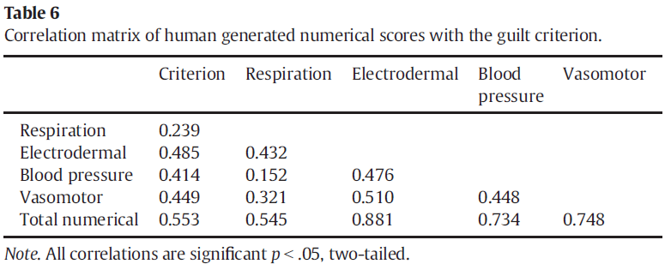
Vasomotor
Q: Is using this additional channel even useful?
Yes! In fact, look at the results of a recent study (Honts & Reavy, 2015):

Slide 81
Detailed

Slide 82
Discriminant Analysis
A discriminant analysis (analysis of the optimal combination of solutions to separate truthful and deceptive subjects) resulted in a three-variable solution retaining electrodermal, vasomotor, and relative blood pressure.
Notice that the optimal combination excluded respiration!

Slide 83
SENSORS-RESPIRATION
TWO TYPES
Traditional mechanical pneumatic bellow sensors
Electronic piezo transducer sensors

Slide 84
SENSORS-EDA
THREE TYPES
Traditional metal finger plates
Disposable non-polarizing electrodes
Re-useable non-polarizing electrodes (Stoelting)

Slide 85
SENSORS-BLOOD PRESSURE
THREE TYPES
Traditional upper arm cuff
Forearm/wrist cuff
Thumb cuff (Limestone).

Slide 86
SENSORS FINGER PULSE AMPLITUDE
ONE TYPE
Sensitive photoelectric plethysmograph

Slide 87
COMPONENT WEIGHT
Some scoring systems assign similar weights to each component when scoring. Some double the EDA due to it contributing approximately half of the diagnostic value.
Hand scoring systems typically use either a 3-position or 7-position point system
UTAH SCORING SYSTEM
+3, +2, +1, 0, -1, -2, -3
FEDERAL SCORING SYSTEM
(7-pos): +3, +2, +1, 0, -1, -2, -3
(3-pos): +1, 0, -1
EMPIRICAL SCORING SYSTEM
Resp, Cardio, FPA: +1, 0, -1
EDA: +2, 0, -2
ALGORITHMS Vary

Slide 88
 | Physiological Features | Fed 3-pos | Fed 7-pos | Utah | ESS
Pneumo | Apnea | X | X | X | X
 | Suppression | X | X | X | X
 | Progressive Decrease | X | X
 | Decrease in Rate | X | X | X | X
 | I/E Ratio Change | X | X
 | Temp. Baseline Increase | X | X | X | X
EDA | Amplitude | X | X | X | X
 | Complexity* | X | X | X
 | Duration* | X | X | X
Cardio | Baseline Arousal | X | X | X | X
 | Duration | X | X | X
 | Rate Decrease | X | X
FPA | Constriction of Amplitude | Soon | Soon | X | X
 | Duration | Soon | Soon | X | X

Slide 89
PRIMARY FEATURES
Respiration - Reduction in respiratory activity (suppression)
Electrodermal Activity (EDA)- increase in skin conductance (or decrease in resistance) response amplitude
Blood Pressure - rise in relative blood pressure baseline
Finger Pulse Amplitude (FPA) – reduction and duration of finger pulse amplitude (Constriction).

Slide 90
SECONDARY FEATURES
Used in Federal and/or Utah scoring if amplitude changes of both comparative questions in either the EDA or BP are equal. These secondary features are sometimes referred to as “tie breakers”. These are NOT used in ESS.
Electrodermal Activity (EDA)
Longer duration of skin conductance reaction
Complexity of skin conductance reaction
Blood Pressure
Longer duration of increased blood pressure
Decrease in heart rate

Slide 91
EDA Why We Don’t Use Complexity or Duration
Kircher, et al 2005 Lens Model for DODPI

Slide 92
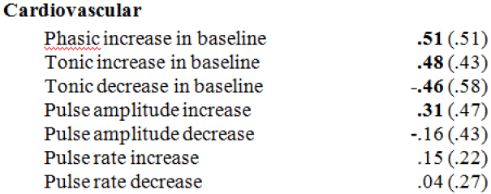
Cardio Why We Don’t Use Rate Decrease
Kircher, et al 2005 Lens Model for DODPI

Slide 93
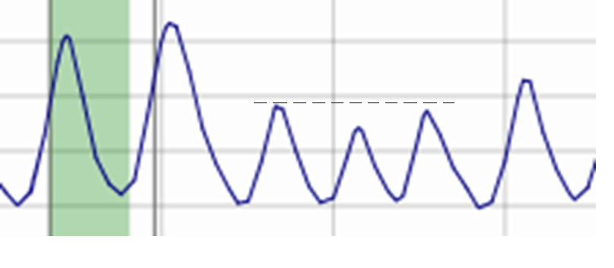
Respiration Reduction of Amplitude (Suppression)
1
2
3
4
ESS & Utah require 3 or more cycles)

Slide 94
Respiration Temporary Increase in Baseline
2
3
4
1
5
ESS & Utah require 3 or more cycles

Slide 95
Respiration Slowing of Rate (or I/E Ratio Change)
1
2
3
ESS & Utah require 3 or more cycles

Slide 96
Respiration Apnea (Suppression)

Slide 97
EDA
Vertical rise of amplitude from lowest point following stimulus onset.

Slide 98
EDA

Slide 99
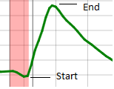
EDA

Slide 100
Cardio
Vertical increase of diastolic baseline.

Slide 101
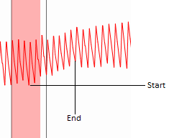
Cardio

Slide 102
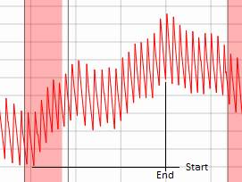
Cardio

Slide 103
Finger Pulse Amplitude (FPA)
Pattern Recognition: Constriction (decrease) in the amplitude of pulses and the duration of the constriction.
CPSPro Assessment Tool: The higher number is the stronger reaction Lafayette Assessment Tool: The higher line position at question onset is the stronger reaction.

Slide 104
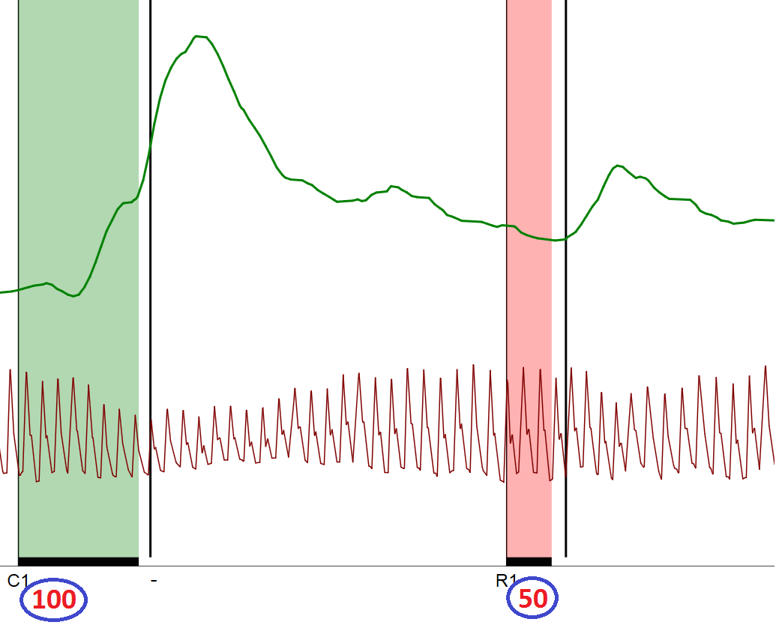
Finger Pulse Restriction - CPSPro

Slide 105
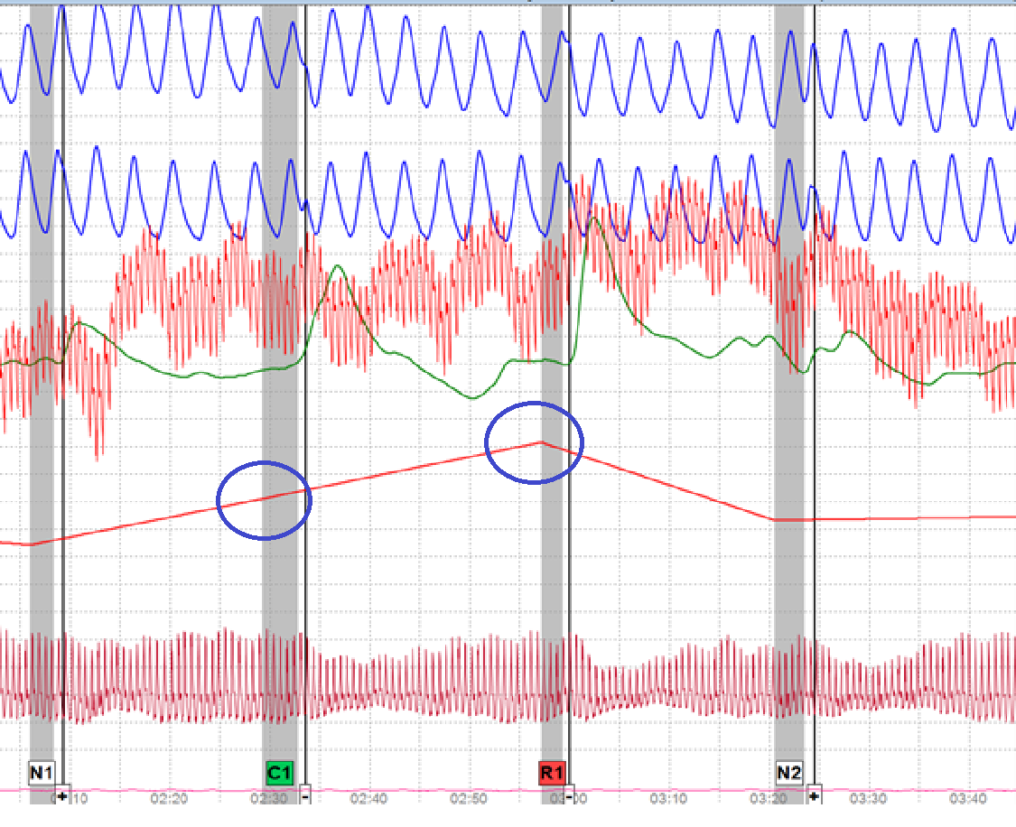
Finger Pulse Amplitude - Lafayette

Slide 106
WHICH CQ TO COMPARE?
There are three approaches to selecting which CQ to compare reactions to:
The adjacent CQ to the left of the RQ
Either of two adjacent CQs (component by component)
If an adjacent CQ is artifacted at a particular component, use the component of the next closest CQ.

Slide 107
RESPONSE ONSET WINDOW (ROW)
Refers to the time period, from stimulus onset, where we are more confident that the physiological reaction that occurred was as a result of the stimulus posed and not for some other reason.
Scoring systems may have different ROWs.

Slide 108
UTAH: HOW FAR TO MEASURE REACTION?
ALL CHANNELS: until 20 seconds after stimulus onset
Note* - this feature alone accounts for the majority of differences between hand-scoring systems.

Slide 109
ESS:HOW FAR TO MEASURE REACTION?
ALL CHANNELS: until end of reaction

Slide 110
FSS:HOW FAR TO MEASURE REACTION?
ALL CHANNELS: until end of reaction

Slide 111
ESS-Response Onset Window
ALL CHANNELS: The beginning of the reaction must occur sometime between stimulus onset until five seconds after the answer or stimulus offset

Slide 112
UTAH-Response Onset Window
RESPIRATION/BP: The beginning of the reaction must occur sometime between stimulus onset and 5.0 seconds after the answer or stimulus offset
FPA: The beginning of the reaction must occur sometime between 2.0 seconds and 5.0 seconds after the answer or stimulus offset.
EDA: The beginning of the reaction must occur sometime between 0.5 seconds after stimulus onset and 5.0 seconds after the answer or stimulus offset

Slide 113
FSS-Response Onset Window
RESPIRATION: The beginning of the reaction must occur sometime between stimulus onset until one complete respiration cycle past the examinee’s answer.
EDA/BP: The beginning of the reaction must occur sometime between stimulus onset until the examinee’s answer.

Slide 114
What Does “Bigger is Better” Mean?
Scores are assigned whenever there is a visibly perceptible difference in the strength of reaction between relevant and comparison questions.
Positive (+) scores are assigned when there is a larger response to the comparison stimulus.
Negative (-) scores when there is a larger response to the relevant stimulus.
Zero (0) is assigned if there is no clear difference between the two.

Slide 115
UTAH Electrodermal Scoring
0.5-second minimum response onset latency
Peak amplitude 2:1=1; 3:1=2; 4:1=3
Peak amplitude + Duration 1.5:1=1
Peak amplitude + Complexity 1.5:1=1

Slide 116
UTAH Cardio Scoring
0-second response onset latency
Baseline increase 1.5:1=1; 3:1=2; 4:1=3
Duration 20 seconds

Slide 117
Federal Scoring System Cardio Scoring
0-second minimum response onset latency
Peak amplitude 2:1=1; 3:1=2; 4:1=3
Peak amplitude + Duration 1.5:1=1
Peak amplitude + Complexity 1.5:1=1

Slide 118
FSS Cardio Scoring
0-second response onset latency
Baseline increase 1.5:1=1; 3:1=2; 4:1=3
Duration useful

Slide 119
Questions?? Contact Me
Chip Morgan
Chip@MorganPolygraph.com
lieguy@gmail.com
208-573-9405

